Slide 1
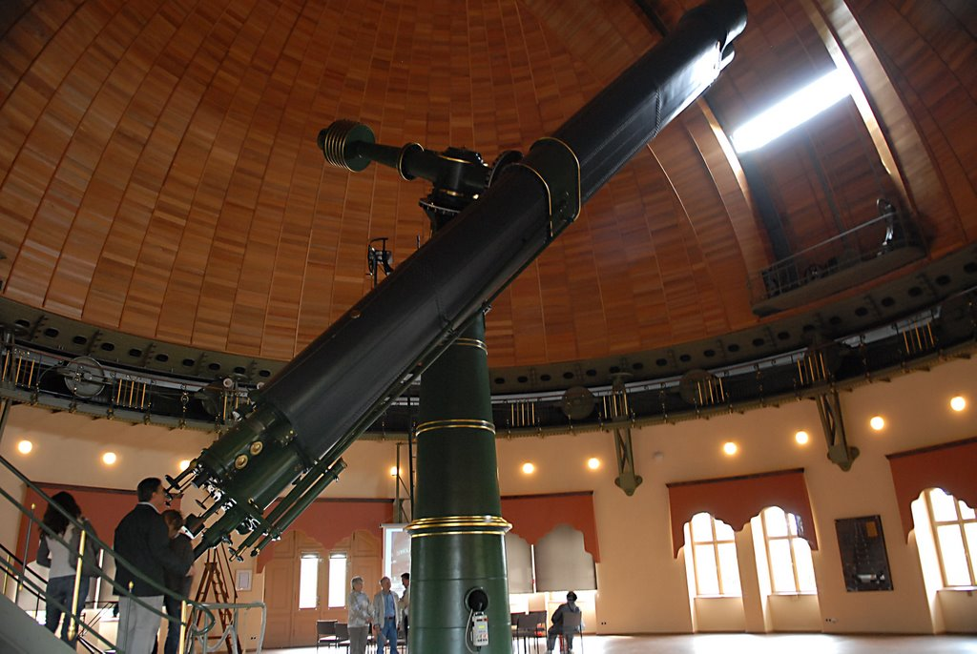

Slide 2
An Overview of Agent-Based Modeling NCAR SEA Conference, 2014
Mike Page
Theory and Practice
mike@mikepage.us
www.linkedin.com/in/MikePageHPC

Slide 3
What is Agent-Based Modeling?
The trivial answer is:
“Agent-Based Modeling is
a software model based on agents”.
http://en.wikipedia.org/wiki/Agent-based_model
http://www.scholarpedia.org/article/Agent_based_modeling

Slide 4
What is an Agent-Based Model?
Definition by contrast:
A mathematical model is a standalone software
system simulating the spatial and temporal
evolution of a physical system.
An agent-based model (ABM) monitors the spatial and temporal evolution of a collection of relatively small, independent, interacting software agents designed to exhibit individual behavior.

Slide 5
What do software agents do?
Software agents exhibit:
Autonomy
Agents have individual control over their actions and can modify their internal state
Agents can make decisions and they can learn
Interactivity / Social Ability
Agents interact with other agents and their environment
Interaction can be physically- and/or sociologically-based
Reactivity
Agents can react to their physical and/or sociological environment
Pro-Activeness
In a sociological model, agents can exhibit goal-directed behavior
M. Wooldridge and N. Jennings, “Intelligent agents: Theory and practice,” Knowledge Engineering Review, vol. 10, no. 2, 1995.

Slide 6
Why Agent-Based Modeling?
Agent-based models offer:
Capture of emergent phenomena that result from the interaction of the individual agents
ABM aka “Interaction-Based Simulation”
Natural representation realistic modeling of behavioral systems
Flexibility in many different dimensions
Agent population can be increased or decreased
Variable
Behavior
Complexity
Ability to learn
Degree of rationality
E. Bonabeau, “Agent-based modeling: Methods and techniques for simulating human systems,” in National Academy of Science, May 2002.

Slide 7
When Are Agent-Based Models Useful?
Agent-based models are useful when:
the interaction between the agents is complex (nonlinear, discontinuous or discrete)
the agents exhibit complex behavior, including learning and adaption
collective agent behaviors reveal emergent phenomena
(more)
“Agent-based modeling in electricity markets: Introducing a new predictive agent learning approach”
Lukas A. Wehinger (CMU/ETH Master’s Thesis, November 2010)

Slide 8
When Are Agent-Based Models Useful? (cont’d)
the model is basically sociological in nature
changes to population, behaviors, constraints, events or environment need to be easily incorporated into the model
memory, path-dependence, learning, adaptation to the environment (non-Markovian behavior) are important
an accurate mathematical model is difficult to derive
Agent-based modeling can be used to simulate
physical phenomena or sociological phenomena or both.
http://www.business-prototyping.com/step-by-step-tutorials/introduction-to-agent-based-modelling/benefits-of-agent-based-modeling

Slide 9
ABM Application Areas
ABMs can be and have been used to simulate:
http://www.openabm.org/model
Social or political systems Governance Opinion dynamics Land use Transportation systems Traffic Pedestrian dynamics Ecological systems Pandemics Infestations Wildfires Resource management Climate adaptation Migration | Physiological systems Infection Tissue modeling Protein cascade Neuroscience Cellular modeling Cancer modeling Economic systems Energy markets Business supply-chains Banking Stock markets Diffusion of innovation Consumerism
www.openabm.org
www.wiki.cas-group.net/index.php?title=Agent-Based_Model

Slide 10
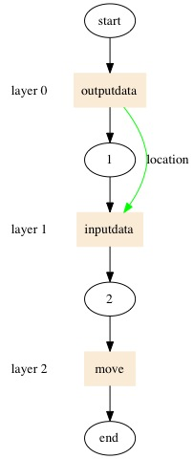
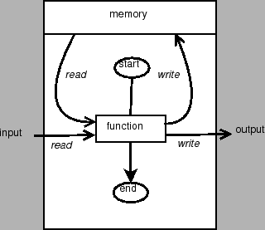
Formal Basis for ABM
A MATHEMATICAL FORMALISM
FOR AGENT-BASED MODELING
REINHARD LAUBENBACHER, ABDUL S. JARRAH, HENNING MORTVEIT, AND S. S. RAVI
time-discrete dynamical systems over finite state sets
(includes probabilistic Boolean networks)
(FSM -> CFSM -> CSXM)
Building blocks (ABM design):
collection of variables (mapping to agent memory)
dependency graph that captures the dependence relations of agents on other agents
a local update function for each agent that encapsulates the rules by which the state of each agent evolves over time
an update discipline for variables in agent memory
arXiv:0801.0249v1 [cs.MA] 31 Dec 2007

Slide 11
Results From the Field
TRANSIMS (LANL)
Agent-based transportation simulations of whole cities
Portland, Washington D.C., Dallas/Fort Worth
Agent-based transportation simulation of Switzerland’s 7.7 million inhabitants
Large-scale evacuations
Natural disasters such as hurricanes
Terrorist attack
Toxic chemical or material release
Physiological systems
ImmSim & CimmSim
Human immune system
Hypersensitivity to chemotherapy
Escape mutants from immune recognition during HIV infection
Persistence of infection with Epstein-Barr virus
Financial Markets
Santa-Fe Stock Market Simulator
U-mart
EURACE simulation of the EU economic system

Slide 12

ABM Software Tools
http://en.wikipedia.org/wiki/Comparison_of_agent-based_modeling_software
Pandora
Mason
Repast
http://www.flame.ac.uk
Simulations of large, complex systems with large agent populations on HPC systems using MPI and OpenMP
Model of computation: extended finite state machines (XFSM)
Developed through a collaboration between STFC Rutherford Appleton Lab and University of Sheffield, UK
Academic license / free download
C- and XML-based
Runs on laptops and HPC systems
Optimized for MIMD architectures using MPI
Needs pthreads to run in parallel

Slide 13
FLAME example - Circles
~mpage/FLAME/circles $ > ls -ltrR
total 24
-rw-r--r--@ 1 mpage staff 1542 Jan 14 05:23 functions.c
-rw-r--r--@ 1 mpage staff 2687 Jan 14 05:23 circles.xml
drwxr-xr-x@ 3 mpage staff 102 Jan 14 10:05 its
./its:
total 8
-rwxr-xr-x@ 1 mpage staff 1533 Jan 14 05:23 init_start_state.py

Slide 14
FLAME example - circles .xml
~mpage/FLAME/circles $ > cat circles.xml
<xmodel version="2" xmlns:xsi="http://www.w3.org/2001/XMLSchema-instance"
xsi:noNamespaceSchemaLocation='http://flame.ac.uk/schema/xmml_v2.xsd'>
<name>Circles</name>
<version>01</version>
<description></description>
<environment>
<functionFiles>
<file>functions.c</file>
</functionFiles>
</environment>
<agents>
<xagent>
<name>Circle</name>
<description></description>
<memory>
<variable><type>int</type><name>id</name><description></description></variable>
<variable><type>double</type><name>x</name><description></description></variable>
<variable><type>double</type><name>y</name><description></description></variable>
<variable><type>double</type><name>fx</name><description></description></variable>
<variable><type>double</type><name>fy</name><description></description></variable>
</memory>
}
Defines filename used for agent functions
}
Defines
variables
in agent
memory

Slide 15
}
<functions>
<function><name>outputdata</name>
<description></description>
<currentState>start</currentState>
<nextState>1</nextState>
<outputs>
<output><messageName>location</messageName></output>
</outputs>
</function>
<function><name>inputdata</name>
<description></description>
<currentState>1</currentState>
<nextState>2</nextState>
<inputs>
<input>
<messageName>location</messageName>
<filter>
<lhs><value>a.id</value></lhs>
<op>NEQ</op>
<rhs><value>m.id</value></rhs>
</filter>
</input>
</inputs>
</function>
<function><name>move</name>
<description></description>
<currentState>2</currentState>
<nextState>end</nextState>
</function>
</functions>
</xagent>
</agents>
Function: outputdata
currentState: start
nextState: 1
messageName: location
}
Function: inputdata
currentState: 1
nextState: 2
messageName: location
Filter: a.id NEQ m.id
}
Function: move
currentState: 2
nextState: end

Slide 16
<messages>
<message>
<name>location</name>
<description></description>
<variables>
<variable><type>int</type><name>id</name><description></description></variable>
<variable><type>double</type><name>x</name><description></description></variable>
<variable><type>double</type><name>y</name><description></description></variable>
</variables>
</message>
</messages>
</xmodel>
}
message: location
variable: id
variable: x
variable: y

Slide 17
FLAME example – functions.c
~mpage/FLAME/circles $ > cat functions.c
#include "header.h"
#define kr 0.1 /* Stiffness variable for repulsion */
#define distance(x1,y1,x2,y2) (sqrt((x1-x2)*(x1-x2)+(y1-y2)*(y1-y2)))
int outputdata()
{
/* read agent memory */
int id = get_id();
double x = get_x(), y = get_y();
/* add message to "location" board (id, x, y) */
add_location_message(id, x, y);
return 0; /* remain alive. 1 = death */
}
}
C code for function “outputdata”
x = get_x
y = get_y
add_location_message(id, x, y)

Slide 18
int inputdata()
{
/* read agent memory */
int id = get_id();
double x1 = get_x(), y1 = get_y();
/* temp vars */
double p, x2, y2;
double core_distance;
double fx = 0, fy = 0;
/* Loop through all messages */
START_LOCATION_MESSAGE_LOOP
x2 = location_message->x;
y2 = location_message->y;
core_distance = distance(x1,y1,x2,y2);
if(core_distance < diameter)
{
p = kr * diameter / core_distance;
/* accumulate forces */
fx += (x1 - x2) * p;
fy += (y1 - y2) * p;
}
FINISH_LOCATION_MESSAGE_LOOP
/* write forces to agent memory */
set_fx(fx);
set_fy(fy);
return 0;
}
}
C code for function “inputdata”
Compute inter-agent forces
}
Write forces to agent memory:
set_fx
set_fy

Slide 19
}
int move()
{
/* update position based on accumulated forces */
set_x( get_x() + get_fx() );
set_y( get_y() + get_fy() );
return 0;
}
C code for function “move”
}
Write new position to agent memory:
set_x( get_x() + get_fx())
set_y( get_y() + get_fy())

Slide 20
FLAME example – procedures
$XPARSER -p circles.xml <invoke FLAME’s parser util
make
cd its
./init_start_state.py 5 5 50 <domain size and agent count
cd ..
mpirun -np 4 ./main 50 its/0.xml <proc count, iteration count
./merge_mpi_xml

Slide 21
FLAME example – procedures Files generated by xparser
stategraph.dot - a directed acyclic graph of the states, functions and messages of agents in the model
stategraph_colour.dot - as above but functions are coloured
process_order_graph.dot - as above but the message syncronisation is shown
latex.dot - a latex document describing the model
Makefile - the compilation script used by the program `make'
xml.c - the source code file that handles inputs and outputs of the simulation
main.c - the source code file containing the main program loop
(more)

Slide 22
FLAME example – procedures Files generated by xparser
header.h - global variables and function declarations between source code files
memory.c - memory requirements of the simulation
low_primes.h - holds data used for partitioning agents
messageboards.c - the source code that handles message functionality
partitioning.c - partitioning of agents between nodes in parallel
timing.c - the source code that provides timing routines
Doxyfile - a configuration file for generating documentation
rules.c - rules for function conditions and message input filters
<agent_name>_agent_header.h - macros for accessing agent memory variables

Slide 23
FLAME example modified -charges-
/* Loop through all messages */
START_LOCATION_MESSAGE_LOOP
/* NOTE: this IF condition is not really required due to filters */
if((location_message->id != id))
{
double x2 = location_message->x;
double y2 = location_message->y;
int charge2 = location_message->charge;
double sep = distance(get_x(),get_y(),x2,y2);
double sep_sqd = distance_sqd(get_x(),get_y(),x2,y2);
if(sep != 0.0)
{
/* accumulate forces */
fx += electro_static_const * ((get_charge() * charge2) / sep_sqd) * (get_x() - x2) / sep;
fy += electro_static_const * ((get_charge() * charge2) / sep_sqd) * (get_y() - y2) / sep;
}
}
FINISH_LOCATION_MESSAGE_LOOP
/* write forces to agent memory */
set_fx(fx);
set_fy(fy);
return 0;
}
Coulomb forces

Slide 24
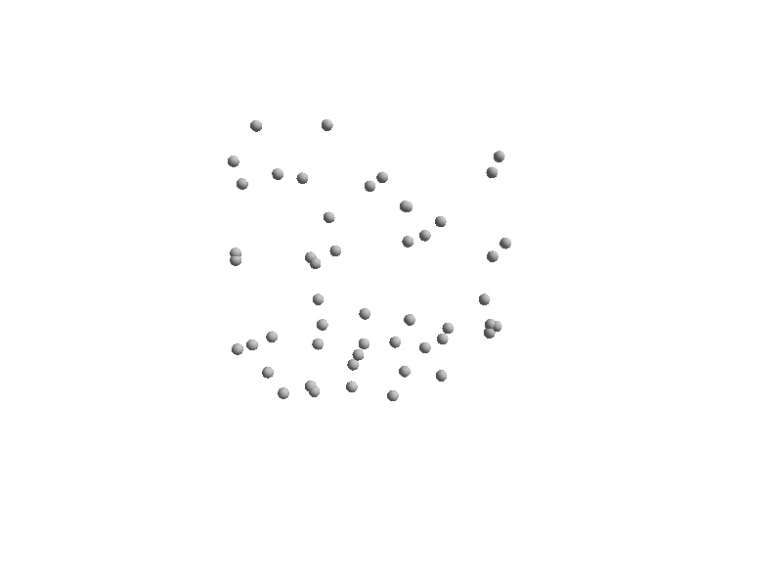
FLAME Example results $XPARSER -p circles.xml
make
its/init_start_state.py 5 5 50
mpirun -np 4 ./main 50 its/0.xml
./merge

Slide 25
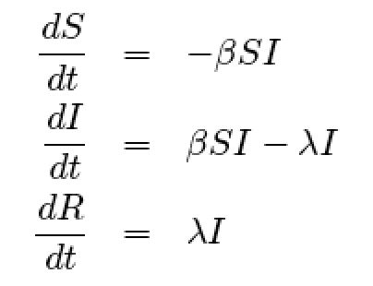
FLAME example Simple SIR Infection Model
SIR – Simple, Infected and Removed
β is the rate of infection
λ is the rate of recovery
Kermack and McKendrick: “A Contribution to the Mathematical Theory of Epidemics” (1927)
http://www.softeng.rl.ac.uk/media/uploads/publications/2012/12/RAL-TR-2012-017.pdf

Slide 26
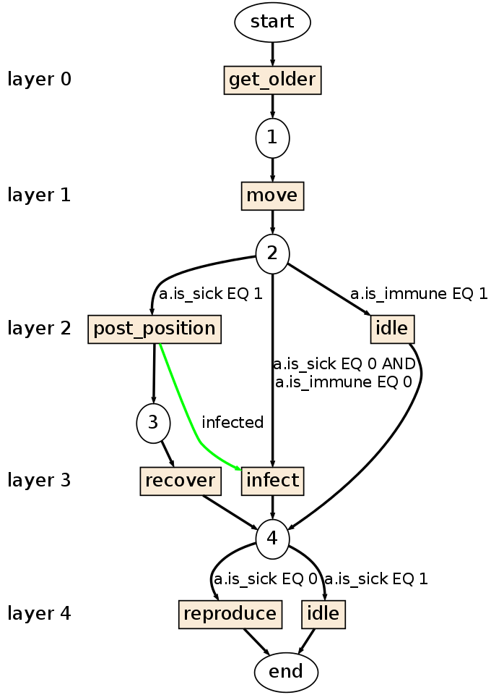
FLAME example Simple SIR Infection Model

Slide 27
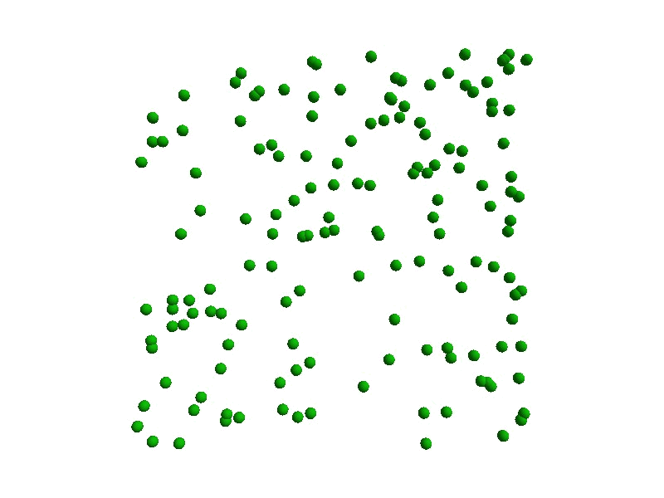
FLAME example Simple SIR Infection Model (250 of 450 frames)

Slide 28
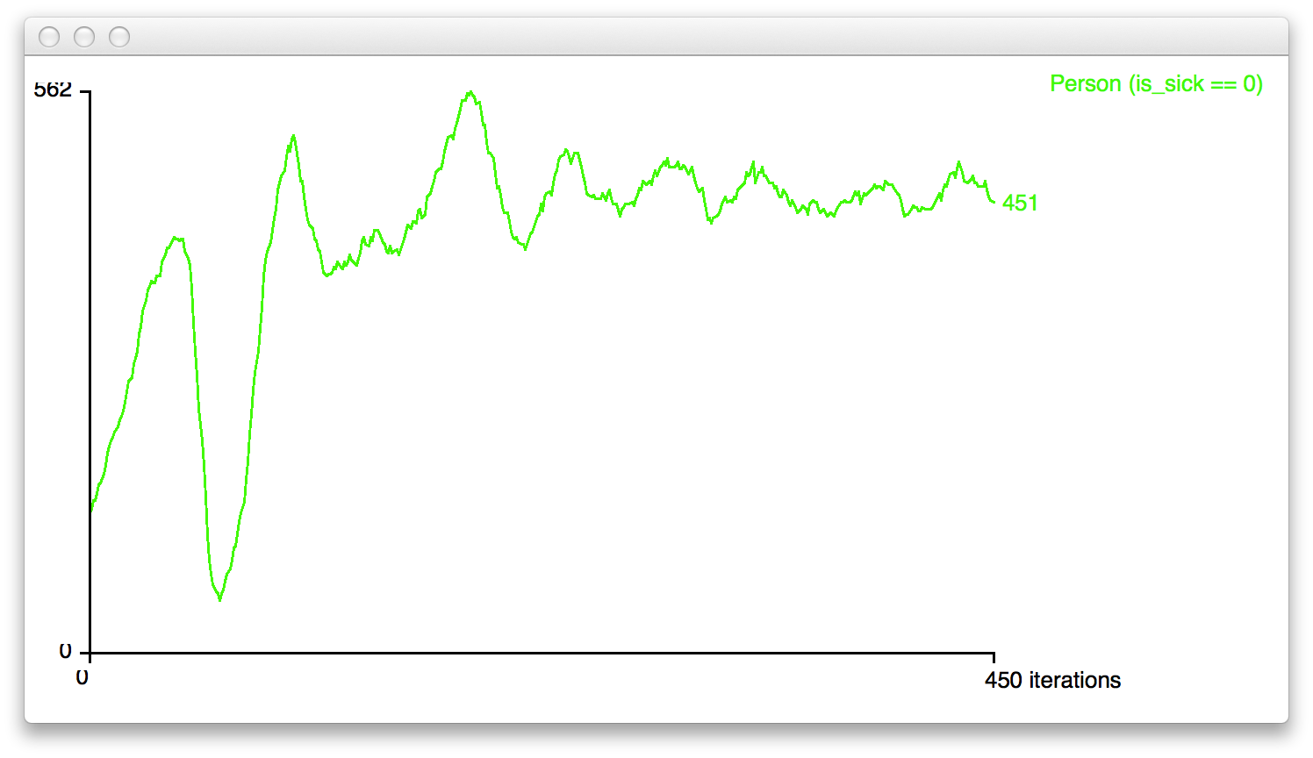
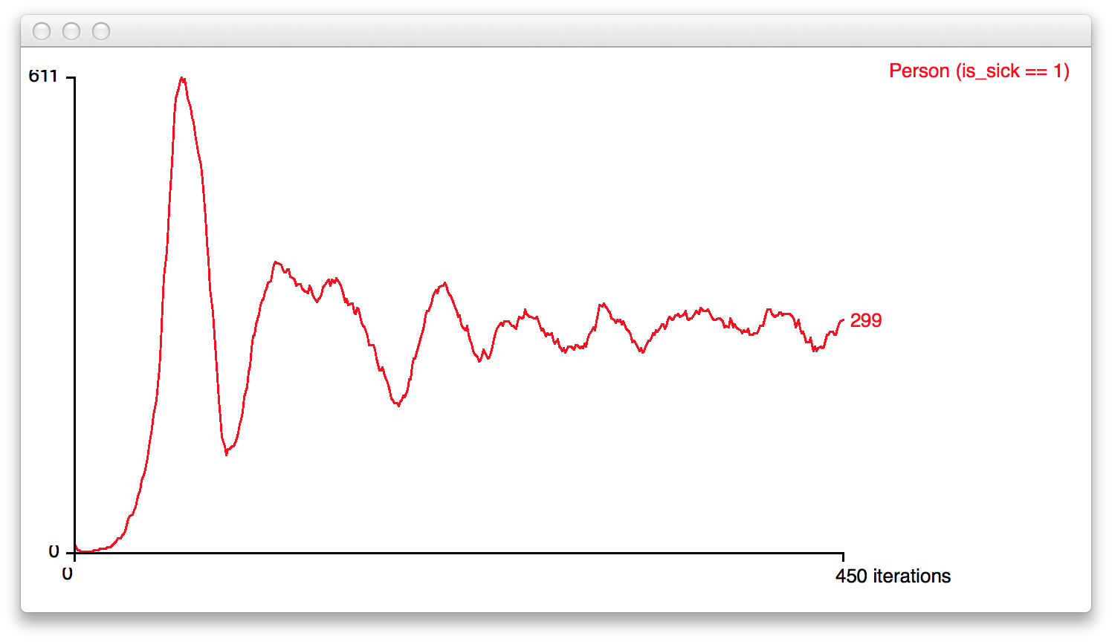
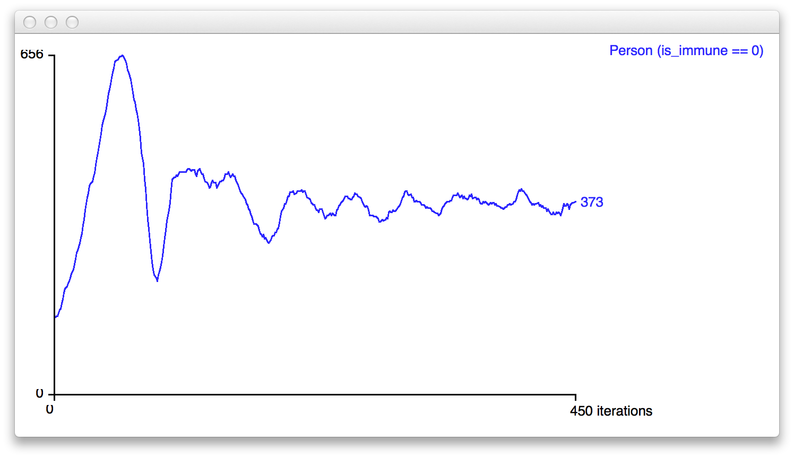
FLAME example Simple SIR Infection Model
Healthy Agents
Sick Agents
Immune Agents

Slide 29
ABM Future
There is a future for ABM in HPC
Larger, more robust, more accurate (?) models
- Thank You -
Questions?
Mike Page
Theory and Practice
mike@mikepage.us
www.linkedin.com/in/MikePageHPC

